Slide 1

IMS Project
Tochukwu Okereafor

Slide 2
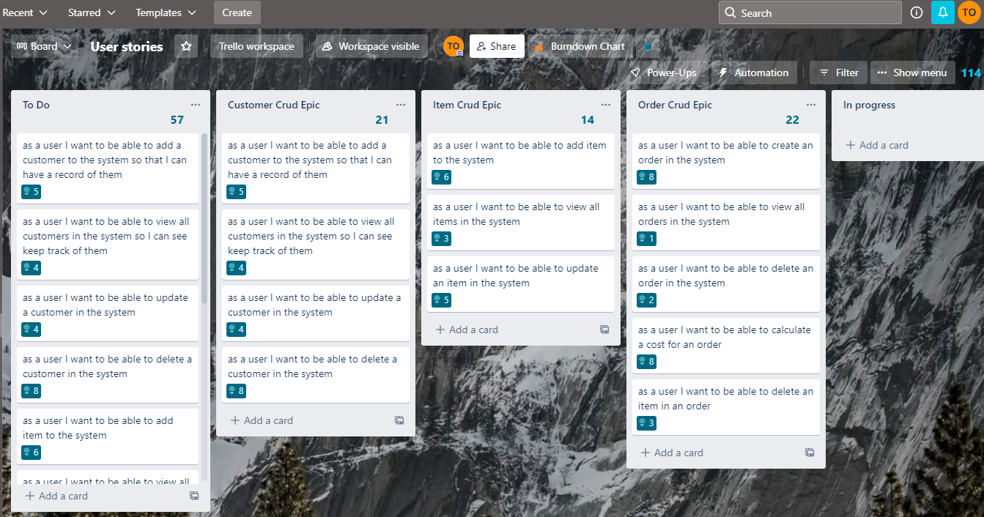
Introduction
Hello my name is Tochi since joining QA I have gained skills in:
Java /JDBC
SQL
Git/GitHub
Project management
Approach
Created a Kanban board using Trello
Drew ERD diagrams based on requirements specification
Link: https://trello.com/b/KOrmhbJ2/user-stories

Slide 3
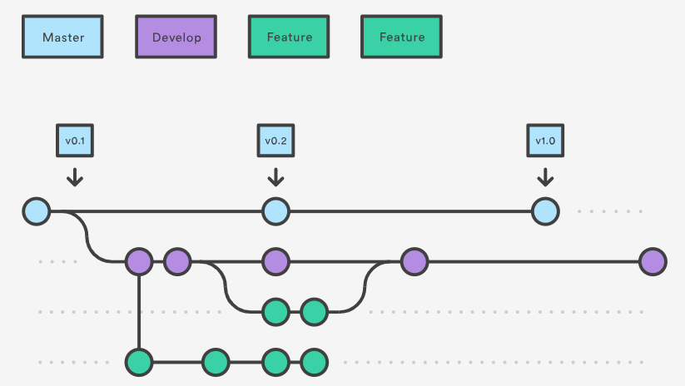
Continuous Integration
I learned and implement the Feature branch model:
Git Was used for version controlling

Slide 4
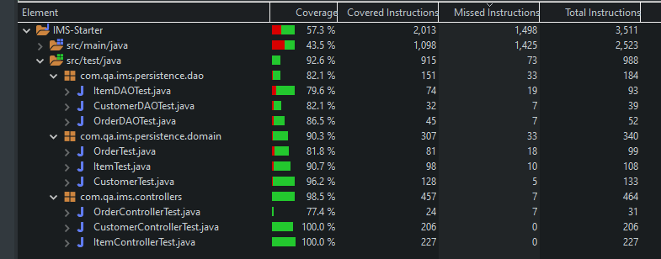
Testing
The Tests I carried out were split into three categories:
Main, DAO, Controller
The Customer, Items and Order each belonged to the three categories mentioned above.

Slide 5
DEMO
Create a customer
Create items
Create an order
Add items to order
Delete items in order
Read order

Slide 6
Sprint Review
What was completed:
ERD
Risk Assessment
Documentation
Full CRUD functionality
What wasn’t completed:
I wasn’t able to add a calculate order function
I wasn’t able to hit a 60% testing bench mark
My build

Slide 7
Sprint Retrospective
What went well:
Understanding JDBC
Better functional grasp of OOP
Using Project management techniques
Git
What could be improved:
Understanding of Mockito
Writing unit tests
Maven Builds

Slide 8
Conclusion
I learned how truly important Git can be
I learned that a well designed ERD diagram prevents roadblocks down the line
I learned the importance of a Kanban board as a productivity tool
The importance of testing

Slide 9
Thank you for listening

